Slide 1
TIC - TAC - TOE
D6AD - Group 6

Slide 2
Content -
Introduction.
Rules of the game.
How AI would be implemented.
Preview of the Game Interface.
Coding Platform.
Team info.

Slide 3
Introduction of the topic :
Everyone is already familiar to the classic Tic-Tac-Toe.
The game is very popular among all the age groups around the world.
It is fairly simple by itself but the real fun begins when we exceed the bounds of the 3x3 Tic-Tac-Toe.
Our Project is an upscaled version of the classic 3x3 Tic-Tac-Toe and supports upto 7x7 grid Tic-Tac-Toe.
The gameplay design is so simple that user won’t find it difficult to use and understand.

Slide 4
RULES :
User is provided to choose the game mode (Two player or Single player), the size { any between 3x3 to 7x7}, Difficulty of AI (Easy, Medium, Hard) and the side[‘O’ or ‘X’]. (or a random side on a coin flip)
The "X" player always goes first and both the players would fill the empty spaces alternatively.
The first player to get 3 of their marks in a row [in 3x3 & 4x4] and 4 [in 5x5, 6x6, 7x7] is the winner. (vertically, horizontally or diagonally)

Slide 5
How it works:
Creating the Board: For a nxn Tic-Tac-Toe board, we will create an array of (n+2)^2 elements. For example, for a 3x3 board, we’ll make an array of 25 elements. This step is required for the easy navigation of the board by our AI.
In case AI plays first, then this move is chosen randomly by using rand( ) function followed by Algorithm generated moves.
The game is run using a while loop until one of the 3 “End Game Conditions” occur:
Human wins.
AI wins.
Draw.

Slide 6
How the AI is implemented:
Backtracking algorithm for the AI.
AI will recursively scan the board (row by row) and look for the win condition. If found, AI will negate the win condition by blocking the row.
In case of no win condition, instead of randomly inserting Os at empty spaces, the AI will play based on the Minimax Algorithm to determine the optimum move (Minimax algorithm explained in the next section).
Here, since the AI plays the first move, it will be initialized as the maximizer.
Notes:
Backtracking is a technique for solving problems recursively by trying to build a solution one piece at a time, removing those solutions that fail to satisfy the constraints of the problem at any point of time.

Slide 7
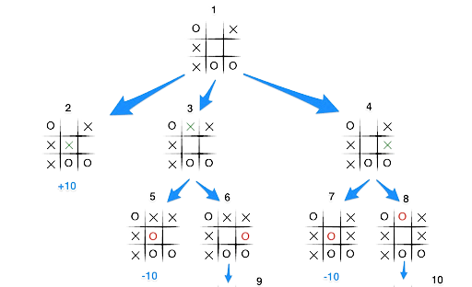
Minimax Algorithm:
Here, X is the maximizer and O is the minimizer.
[And Also, Heuristic Search]

Slide 8
It is used to determine the best move possible. To understand the algorithm, let’s determine a “score” for a game state at any interval of time. On winning : score = +10. On losing : score = -10. For draw : score = 0.
In Minimax the two players are called maximizer and minimizer. The maximizer tries to get the highest score possible while the minimizer tries to do the opposite and get the lowest score possible for the opponent.
Here is how the algorithm will look : a. Create a scores list. b. For each state of the game, add the minimax result of that state to the scores list. c. If it's maximizer's turn, return the maximum score
from the scores list and vice versa. d. Repeat the steps until the game is over.

Slide 9
Coding Platform:
Backend : Python.
Frontend : HTML, CSS, JAVASCRIPT.
followed by preview of
THE GAME INTERFACE.
Notes:
Flask is a web framework of python.

Slide 10

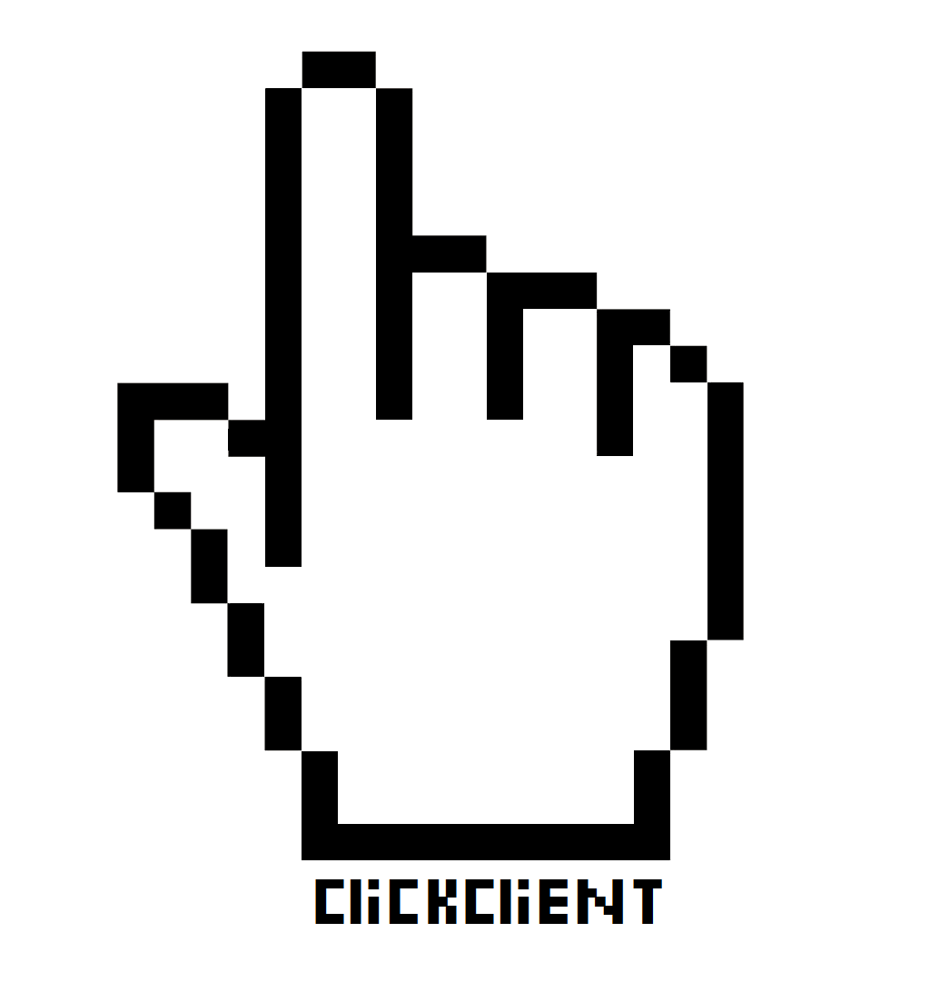
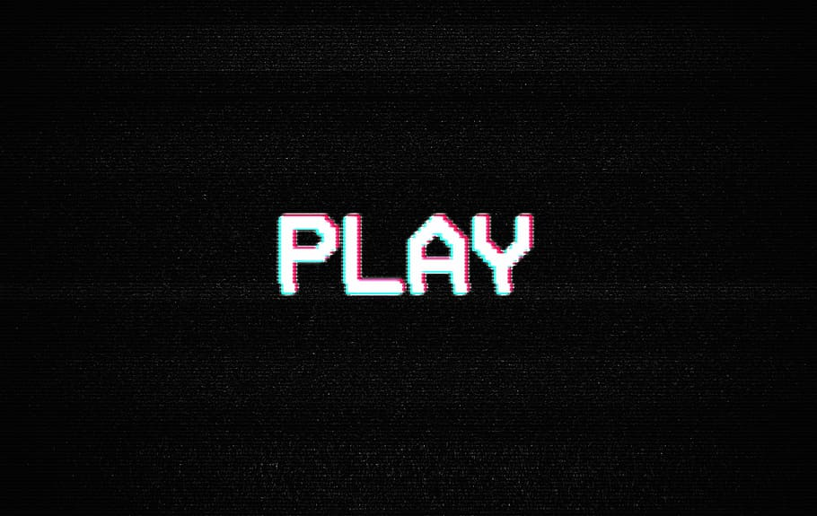
Tic-Tac-Toe x
Tic-Tac-Toe {upto 7x7}
Singleplayer(vs AI)
Local Multiplayer

Slide 11

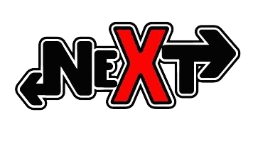
Tic-Tac-Toe x
Please read and comply to the rules before you play.
Main Menu
Rules!!!
Source Code.
Feedback?
Report a bug.
Contact us.
What player would you like to play as?
X (plays first)
O
Choose your preferred type of game: ___________________________________
(Place 3 consecutive to win)
3 x 3
4 x 4
(Place 4 consecutive to win)
5 x 5
6 x 6
7 x 7

Slide 12
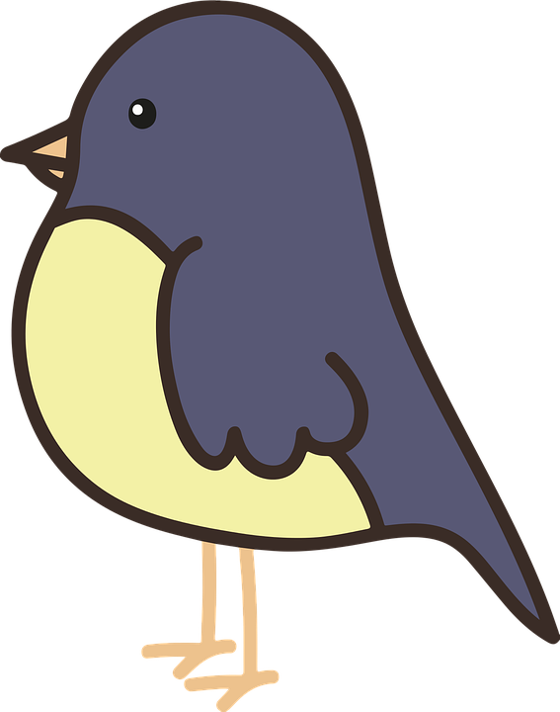

Tic-Tac-Toe x
X - Bot CHAD. (AI) O - Timmy.
O |  |  |  | O |  | X
 | X |  | O
 |  | O
 | X | X | X
 |  | X | O
 | X |  |  | X
 |  |  |  |  |  | X

Slide 13

TEAM FOR THE PROJECT: Anjali Ma’am (MENTOR) Shreya Singh
Parth Suryavanshi
Surabhi Tambe
Yash Sarang

Slide 14
Thank You.
We Hope you liked our presentation, We hope that you provide us proper feedback to improve our project in any aspect.

